Slide 1
LiveTiles Limited
Q1 FY20 Investor Update
29 October 2019

Slide 2
Disclaimer
All currency amounts in this presentation are in Australian Dollars (AUD).
This presentation has been prepared by LiveTiles Limited (“LiveTiles”). Each recipient of this presentation is deemed to have agreed to accept the qualifications, limitations and disclaimers set out below.
None of LiveTiles, its subsidiaries or respective directors, officers, employees, advisers or representatives (“Beneficiaries”) make any representation or warranty, express or implied, as to the accuracy, reliability or completeness of the information contained in this presentation, including any forecast or prospective information. The forward looking statements included in this presentation involve subjective judgement and analysis and are subject to significant uncertainties, risks and contingencies, many of which are outside the control of, and are unknown to, the Beneficiaries. Actual future events may vary materially from the forward looking statements and the assumptions on which those statements are based. Given these uncertainties, you are cautioned to not place undue reliance on such forward looking statements.
This presentation is a general overview only and does not purport to contain all the information that may be required to evaluate an investment in LiveTiles. The information in this presentation is provided personally to the recipient as a matter of interest only. It does not amount to an express or implied recommendation with respect to any investment in LiveTiles, nor does it constitute financial product advice.
The recipient, intending investors and respective advisers should:
conduct their own independent review, investigations and analysis of LiveTiles and of the information contained or referred to in this presentation; and/or
seek professional advice as to whether an investment in LiveTiles is appropriate for them, having regard to their personal objectives, risk profile, financial situation and needs.
Nothing in this presentation is or is to be taken to be an offer, invitation or other proposal to subscribe for shares in LiveTiles.
Except insofar as liability under any law cannot be excluded, none of the Beneficiaries shall have any responsibility for the information contained in this presentation or in any other way for errors or omissions (including responsibility to any persons by reason of negligence).

Slide 3
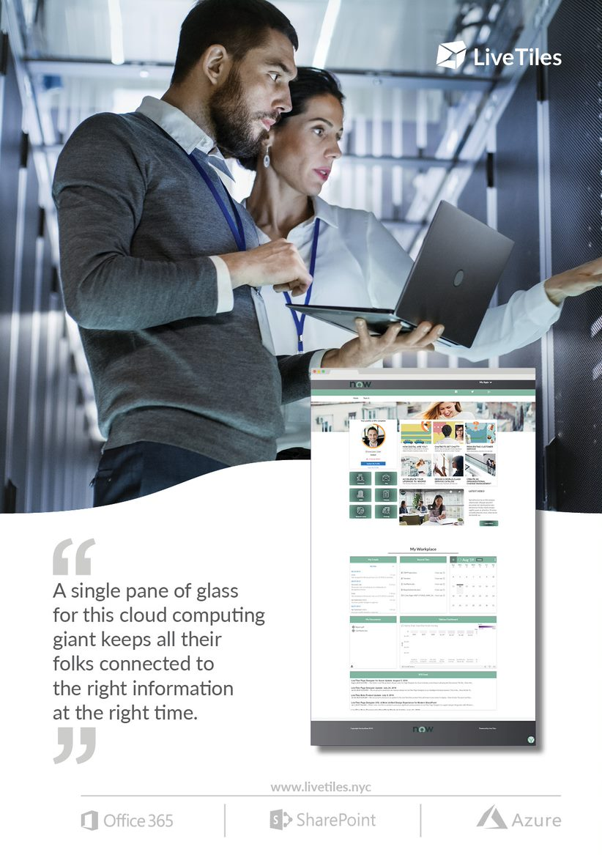
LiveTiles Q1 Snapshot
Q1 Highlights
$42.9m of annualised recurring revenue (ARR) ⁽¹⁾, up 131% on pcp
952 paying customers across every major industry vertical
185 transacting partners²
Large and rapidly growing addressable market
Pleased with sales and marketing activity early in Q2
Strengthening pipeline - early customer and partner response to Wizdom and bundling driving pipeline growth
Bundles: longer sales cycle, higher average contract value and retention rate
Larger and more engaged partner channel
As at 30 September 2019. Annualised recurring revenue (ARR) represents committed, recurring revenue on an annualised basis.
LiveTiles resellers that have closed at least one LiveTiles software licensing transaction

Slide 4
Strong Recurring Revenue Growth
Year-on-year ARR growth ⁽¹⁾
Average ARR per customer up 37% YoY
Strong growth in average ARR per customer (+37% in last twelve months) driven by:
A higher proportion of new enterprise customers
Product cross-sell / bundling
Increased penetration of existing customers
Q1 ARR +131% on pcp
One of the world’s fastest-growing SaaS companies
Acquisition of Wizdom, Europe’s leading ‘plug and play’, Microsoft-aligned digital workplace software business, completed in Feb 2019
Q1 in line with expectations, strong pipeline of sales opportunities in FY20
Acquired ARR comprises Wizdom’s ARR as at 31 December 2018 ($8.0 million) and Hyperfish’s ARR as at 30 June 2018 ($0.4 million). Figures in A$ millions.

Slide 5
Substantial Cash Flow Improvement
Strong Growth in Customer Cash Receipts
Improving Net Operating Cash Flow
Strong growth in customer cash receipts continued in Q1FY20
Another record quarter in Q1
Fourth consecutive record quarter
Fifth consecutive quarter of net operating cash flow improvement
$3.8m R&D tax incentive received during Q1
Underlying opex of $16.4m vs guidance of $15.9m
Non-operating opex relating to discontinued salary and contractor costs, legal costs and costs relating to capital raising
Q2 opex expectations of ~$16.2m

Slide 6
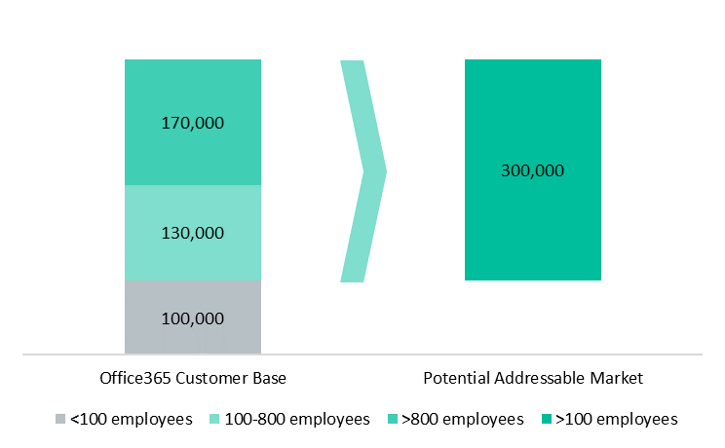
Global Market Opportunity: intranet software
Large and rapidly-growing addressable market of ~300,000 organisations
Microsoft Office365 Customer Base ⁽¹⁾
Total Potential Addressable Market
Almost all organisations with >100 employees utilise some form of intranet or employee portal
Almost all use custom-coded intranets without benefit of intranet software
Strong growth in Microsoft’s Office365 Commercial revenue: +34% YoY ⁽³⁾
300,000 Potential Customers
x $43.6k Average ARR per Customer ⁽²⁾
= ~$13 billion pa
Each 1% market penetration = ~$130m ARR
LiveTiles estimates based on industry knowledge.
LiveTiles’ average annualised recurring revenue (ARR) per customer as at 30 June 2019.
Microsoft Q4 FY19 earnings release (constant currency basis).

Slide 7
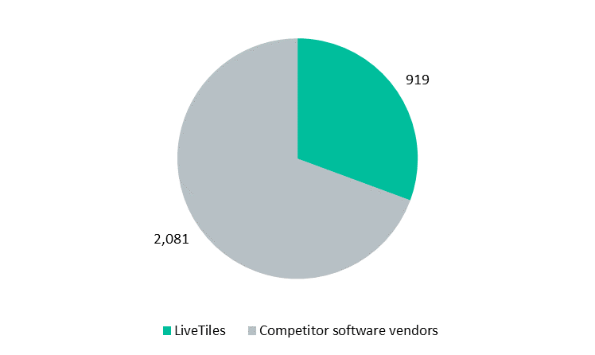
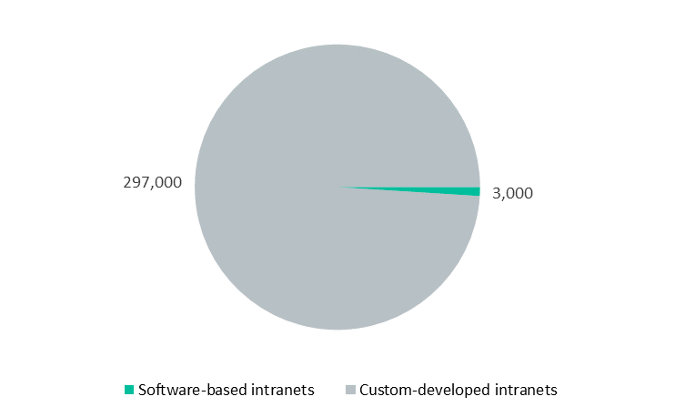
Clear Global Market Leader
Software-based intranets are in the early stages of replacing custom-coded intranets
Leading Market Share ⁽¹⁾
Penetration of Software-based Intranets ⁽¹⁾
LiveTiles is more than 4x larger than its nearest competitor (by revenue)
Most competitor software vendors are embedded within systems integrator (consulting) businesses
Internal organisation intranets and portals have historically been custom-coded - common frustrations with cost, lack of features and lack of dynamic change
LiveTiles pioneered the market for low/no-code intranet software in 2015
LiveTiles is pursuing market conversion through direct, partner and Microsoft channels
Number of organisations (LiveTiles estimates based on industry knowledge).

Slide 8
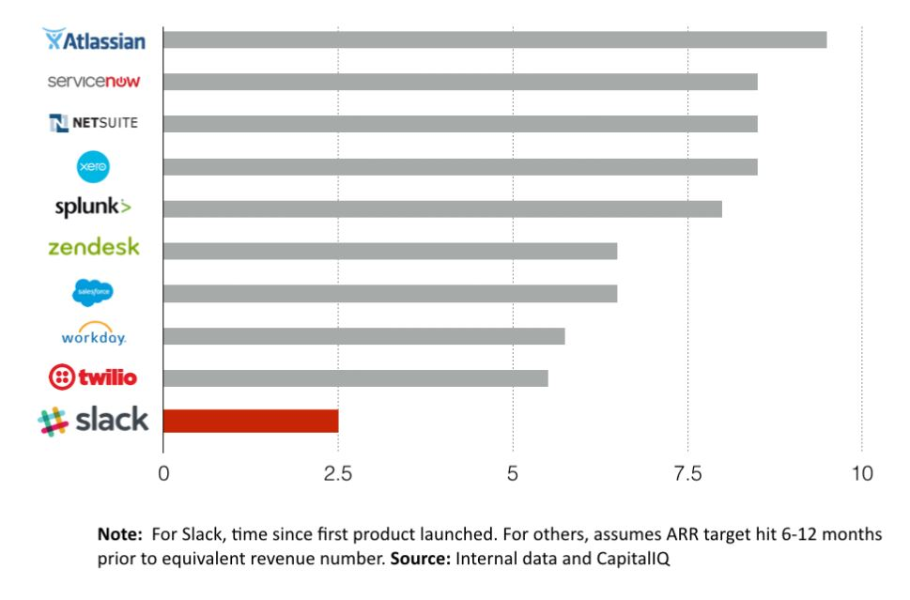
Growth Benchmarking: Years to US$100M in ARR
LiveTiles is targeting A$100m ARR in ~6.25 years since initial product launch¹
1. The Company’s A$100M ARR target is not a forecast or guarantee of future performance. It depends on a number of assumptions and is subject to risks, including the risk factors set out in the Company’s presentation lodged with ASX on 18 September 2019.
Chart source: https://medium.com/startup-grind/growing-as-fast-as-slack-195c1e194561

Slide 9
Growth Outlook
LiveTiles expects to deliver another year of strong customer and revenue growth in FY20
Large and growing addressable market
Focused direct sales & marketing strategy targeting larger enterprises
Conversion of large pipeline generated by inside sales team in the United States
High-impact co-marketing initiatives with Microsoft
Continued growth in partner/reseller distribution channel
Growing demand for Artificial Intelligence products
Substantial expansion opportunity with existing customers via cross-sell, bundling and increased penetration
Technology alliances
LiveTiles’ publicly stated target is to organically grow ARR to at least $100m by 30 June 2021¹
1. The Company’s A$100M ARR target is not a forecast or guarantee of future performance. It depends on a number of assumptions and is subject to risks, including the risk factors set out in the Company’s presentation lodged with ASX on 18 September 2019.

